Slide 1
IMPORTACIONES 2014 VOLUMEN POR PRODUCTO ENERO-DICIEMBRE 2014
RECOPE
IMPORTACIONES POR PRODUCTO
ENERO-DICIEMBRE 2014
HIDROCARBUROS |  | VOLUMEN BARRILES | MONTO (Dólares)
PRODUCTOS | ASFALTO AC-30 | 411.850 | 37.128.030
 | AVGAS | 8.819 | 1.790.044
 | DIESEL 0.0015% S | 7.242.379 | 849.186.095
 | ETANOL | 1.712 | 231.520
 | FUEL OIL 1.8% | 1.196.112 | 118.080.299
 | FUEL OIL 3% S | 867.836 | 75.668.132
 | GASOLINA RON 91 | 3.692.423 | 393.732.870
 | GASOLINA RON 95 | 3.107.289 | 349.313.133
 | JET FUEL | 1.411.136 | 167.378.314
 | LPG | 1.564.623 | 103.341.020
 | MTBE | 69.978 | 9.982.841
TOTAL |  | 19.574.156 | 2.105.832.298

Slide 2
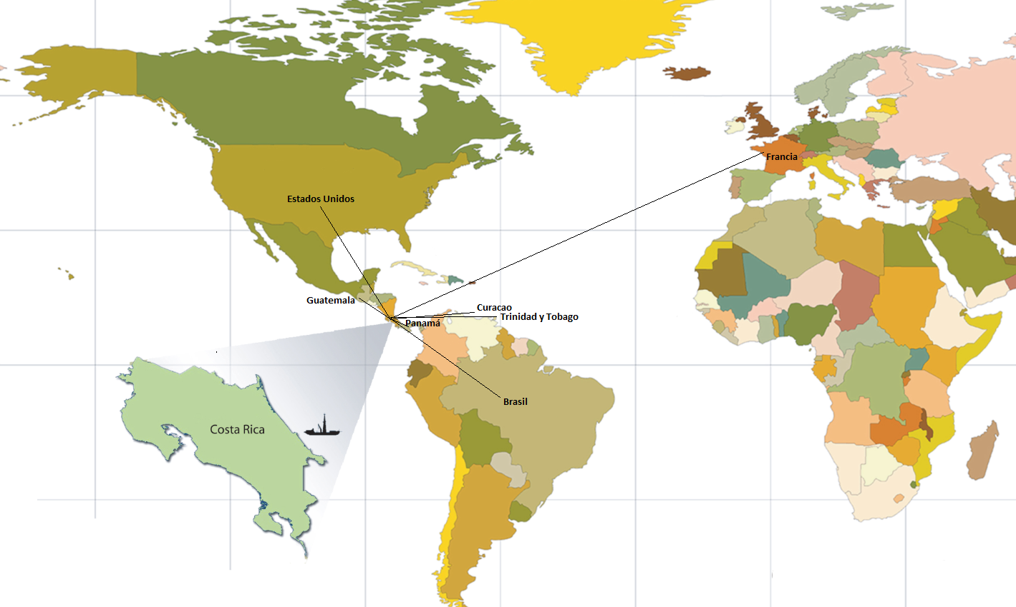
IMPORTACIONES 2014 VOLUMEN POR PRODUCTO ENERO-DICIEMBRE 2014
Volumen de Importaciones por país de procedencia 2014
Total 19.574.156 de barriles
Barriles

Slide 3
IMPORTACIONES 2014 EVOLUCIÓN IMPORTACIONES ANUALES 1986-2014
AÑO | VOLUMEN | MONTO CIF | PRECIO CIF
 | BARRILES | $ | $/BARRIL
1986 | 6.424.561 | 101.849.041 | 15,85
1987 | 6.388.362 | 121.086.856 | 18,95
1988 | 6.951.695 | 114.150.180 | 16,42
1989 | 7.491.059 | 147.878.260 | 19,74
1990 | 7.481.530 | 191.785.580 | 25,63
1991 | 7.919.333 | 185.875.718 | 23,47
1992 | 9.622.404 | 211.909.324 | 22,02
1993 | 10.751.511 | 215.402.962 | 20,03
1994 | 12.188.569 | 235.373.779 | 19,31
1995 | 12.848.122 | 259.067.858 | 20,16
1996 | 12.137.378 | 296.414.462 | 24,42
1997 | 12.090.545 | 276.650.864 | 22,88
1998 | 13.450.649 | 228.663.639 | 17,00
1999 | 14.603.915 | 298.439.550 | 20,44
2000 | 13.955.086 | 455.418.379 | 32,63
2001 | 14.400.595 | 420.549.702 | 29,20
2002 | 15.267.615 | 423.511.908 | 27,74
2003 | 15.222.032 | 525.940.911 | 34,55
2004 | 15.685.416 | 699.309.117 | 44,58
2005 | 16.078.701 | 997.841.299 | 62,06
2006 | 17.394.173 | 1.249.009.575 | 71,81
2007 | 18.369.405 | 1.444.048.516 | 78,61
2008 | 19.167.453 | 2.091.011.849 | 109,09
2009 | 18.062.249 | 1.239.536.441 | 68,63
2010 | 18.530.723 | 1.604.351.458 | 86,58
2011 | 18.714.224 | 2.189.340.880 | 116,99
2012 | 18.024.460 | 2.175.639.176 | 120,70
2013 | 18.864.093 | 2.181.766.830 | 115,66
2014 | 19.574.156 | 2.105.832.298 | 107,58

Slide 4
IMPORTACIONES 2014 EVOLUCIÓN IMPORTACIONES ANUALES 1986-2014

